Slide 1
Module 2 - Output Primitives Topic: Midpoint Algorithm for Circle

Slide 2
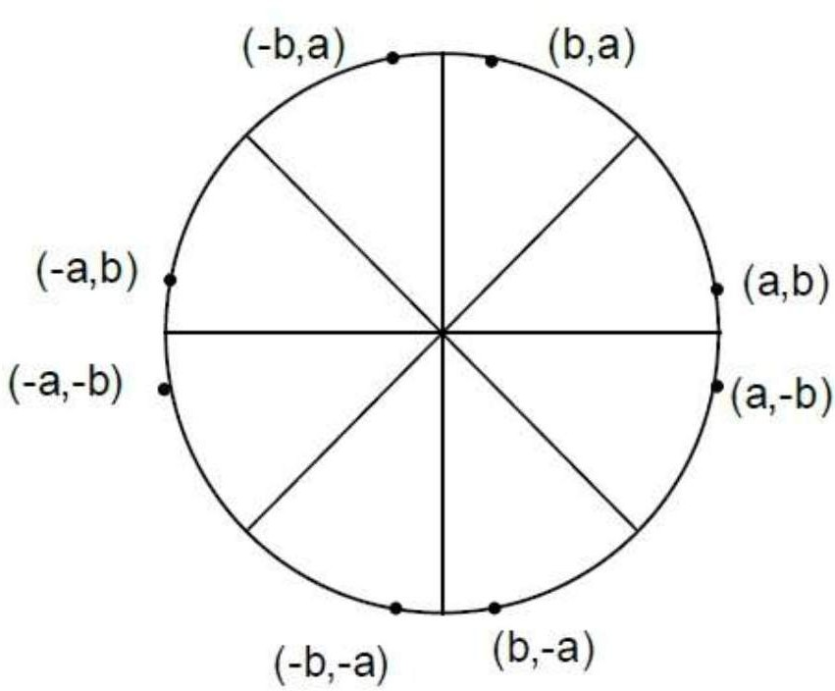
Circle
O8 O1
A Circle is a set of points that lie at an equal distance from the center which is a fixed point
Equal Distance is the Radius
Circle is a Symmetric Figure
8 - way symmetry in circle which gives us 8 octants
Eqn of Circle is : x² + y² = r² [with center is the origin (0,0) ]
O7
O2
45°
O6
O3
O5 O4
If the circle is centered at [x_{c} , y_{c}], it should be translated to origin to plot the circle. The equation of circle in this case would be (x-x_{c} )²+ (y- y_{c} )² = r²

Slide 3
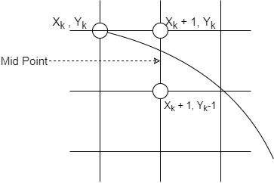
Understanding the Mid Point
Eqn of Circle is : x² + y² = r² [with center is the origin (0,0) ]
x² + y² - r² = 0, insert x, y and r
If = 0, Point Lies on the Circle
If < 0, Point Lies inside the Circle
If > 0, Point Lies outside the Circle
X k+1 , Yk
X k+1 , Y k-1
X k+2 , Yk
X k+2 , Y k-1
X k+2 , Yk-1
X k+2, Y k-2
X k+2 , Yk-1/2
X k+2, Yk - 3/2

Slide 4


Derivation Continued….
Now points to decide from (x_{k} + 1, y_{k}) and (x_{k} + 1, y_{k}-1)
Midpoint of these two points will be

Slide 5


Derivation Continued….
If P_{k} < 0, then choose y_{k+1} = y_{k}
If P_{k} >= 0, then choose y_{k+1} = y_{k} - 1

Slide 6

Initial P₀
Initially x_{k} = 0 and y_{k} = r
= 1 + r² -r + 1/4 - r²
P₀ = 1 - r (We are interested in sign and not magnitude, so make a slight modification to the above equation)

Slide 7
Let’s Plot the ﬁrst Quadrant
Plot the initial (x_{k} , y_{k} ) i.e. x_{k} = 0 and y_{k} = r
Find the Initial Decision Parameter
3. If P < 0, then choose y = y
Repeat 3 and 4 until x becomes greater than or equal to y
To plot the entire circle use the 8-way symmetry
k
x_{k+1} = x_{k} + 1
k+1 k
○
^{y}k+1 ^{= y}k
○
If P_{k} > = 0, then choose y_{k+1} = y_{k} - 1
x_{k+1} = x_{k} + 1
y_{k+1} = y_{k} - 1

Slide 8
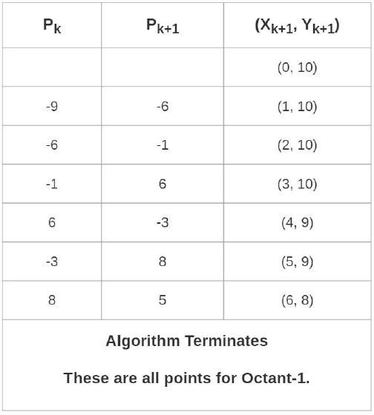
Example

Slide 9
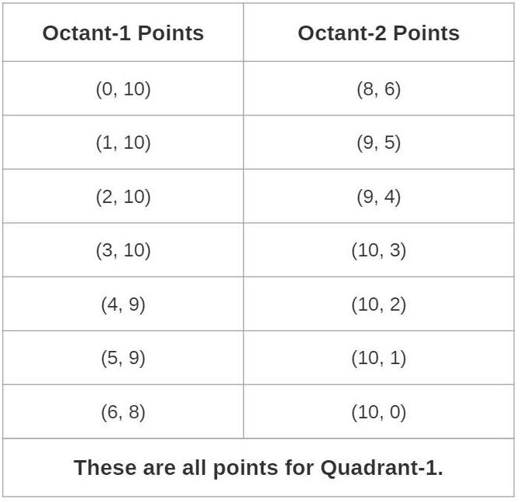
Oct 2 from Oct 1

Slide 10
References
Hearn & Baker, “Computer Graphics C version”, 2nd Edition, Pearson Publication

